Slide 1
Activity 1:
BitCoin
Team 6 : Benedict, Hendy, Kang Jie, MinHui, Olivia

Slide 2
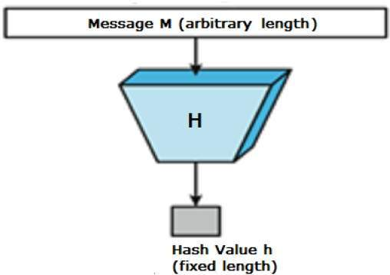

What is a cryptographic hash function? How does that differ from “non-cryptographic” hash functions?
Unique identifier for any given piece of content
Algorithm that takes an arbitrary amount of data input—a credential—and produces a fixed-size output of enciphered text called a hash value, or just “hash.”
Non-cryptographic hash functions provide weaker guarantees in exchange for performance improvements. They just try to avoid collisions for non malicious input. An example would be to detect data corruption due to an unstable network.
Difference is in “uniqueness”. An acceptable cryptographic hash has all the properties of a non-cryptographic hash, plus the fact that it creates a unique hash output.
Notes:
https://security.stackexchange.com/questions/11839/what-is-the-difference-between-a-hash-function-and-a-cryptographic-hash-function#:~:text=Non%20cryptographic%20hash%20functions%20just,are%20typically%20(much)%20faster.

Slide 3

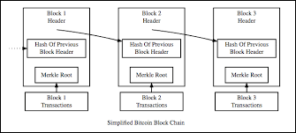
Why do we care about cryptographic hash function when we discuss about bitcoin?
To increase the computational work put in by miners to prevent fraudulent transactions through proof of work
Proof of work: The users of bitcoin trust the blockchain with the most computational work put into it as it is infeasible to produce a fraudulent blockchain
Notes:
Idk this is hard

Slide 4


